Slide 1









Whiteboardmaths.com
7
2
1
5
© 2004 All rights reserved

Slide 2

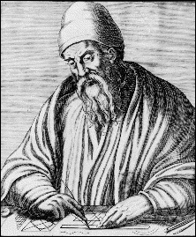
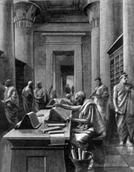
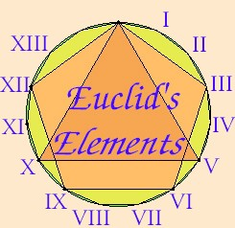
Circle Theorems
Euclid of Alexandria
Circa 325 - 265 BC
The library of Alexandria was the foremost seat of learning in the world and functioned like a university. The library contained 600 000 manuscripts.
O

Slide 3
Parts
A Reminder about parts of the Circle
Circumference
Major Arc
Tangent
radius
Major Segment
diameter
Tangent
chord
Minor Segment
Major Sector
Minor Arc
Minor Sector
Tangent

Slide 4
Term’gy
Introductory Terminology
yº
yº
o
o
xº
xº
B
A
B
B
A
A
Arc AB subtends angle x at the centre.
o
xº
Arc AB subtends angle y at the circumference.
yº
Chord AB also subtends angle x at the centre.
Chord AB also subtends angle y at the circumference.

Slide 5
Th1
Theorem 1
Measure the angles at the centre and circumference and make a conjecture.
xº
xº
xº
o
o
o
o
yº
yº
yº
yº
xº
xº
xº
xº
xº
o
o
o
o
yº
yº
yº
yº

Slide 6
The angle subtended at the centre of a circle (by an arc or chord) is twice the angle subtended at the circumference by the same arc or chord. (angle at centre)
Theorem 1
Measure the angles at the centre and circumference and make a conjecture.
xº
xº
xº
o
o
o
o
2xº
2xº
2xº
2xº
xº
Angle x is subtended in the minor segment.
xº
xº
xº
xº
o
o
o
o
2xº
2xº
2xº
2xº
Watch for this one later.

Slide 7
Example Questions
Find the unknown angles giving reasons for your answers.
1
2
xº
o
35º
o
84º
yº
A
A
B
B
angle x =
42º (Angle at the centre).
angle y =
70º(Angle at the centre)

Slide 8
Example Questions
Find the unknown angles giving reasons for your answers.
3
4
yº
62º
B
o
o
qº
xº
pº
42º
A
B
A
angle x =
(180 – 2 x 42) = 96º (Isos triangle/angle sum triangle).
angle y =
48º (Angle at the centre)
angle p =
124º (Angle at the centre)
angle q =
(180 – 124)/2 = 28⁰ (Isos triangle/angle sum triangle).

Slide 9
Th2
Theorem 2
The angle in a semi-circle is a right angle.
This is just a special case of Theorem 1 and is referred to as a theorem for convenience.
Find the unknown angles below stating a reason.
o
Diameter
a
30º
c
angle a =
90º angle in a semi-circle
d
o
angle b =
90º angle in a semi-circle
angle c =
20º angle sum triangle
e
angle d =
90º angle in a semi-circle
70º
b
angle e =
60º angle sum triangle

Slide 10
Th3
Angles subtended by an arc or chord in the same segment are equal.
Theorem 3
yº
xº
xº
xº
yº
xº
xº

Slide 11
Theorem 3
Angles subtended by an arc or chord in the same segment are equal.
Find the unknown angles in each case
yº
38º
xº
30º
40º
yº
xº
Angle x = angle y = 38º
Angle x = 30º
Angle y = 40º

Slide 12
Th4
The angle between a tangent and a radius is 90^{o.} (Tan/rad)
Theorem 4
o

Slide 13
The angle between a tangent and a radius is 90^{o.} (Tan/rad)
Theorem 4
o

Slide 14
If OT is a radius and AB is a tangent, find the unknown angles, giving reasons for your answers.
30º
o
xº
B
36º
yº
zº
T
A
angle x =
180 – (90 + 36) = 54º Tan/rad and angle sum of triangle.
angle y =
90º angle in a semi-circle
angle z =
60º angle sum triangle

Slide 15
Th5
Theorem 5
The Alternate Segment Theorem.
The angle between a tangent and a chord through the point of contact is equal to the angle subtended by that chord in the alternate segment.
Find the missing angles below giving reasons in each case.
xº
yº
xº
60º
yº
xº
zº
45º
yº
angle x =
45º (Alt Seg)
angle y =
60º (Alt Seg)
angle z =
75º angle sum triangle

Slide 16
Th6
Theorem 6
Cyclic Quadrilateral Theorem.
The opposite angles of a cyclic quadrilateral are supplementary. (They sum to 180º)
y
p
x
q
z
w
s
r
Angles y + w = 180º
Angles p + r = 180º
Angles x + z = 180º
Angles q + s = 180º

Slide 17
Theorem 6
Cyclic Quadrilateral Theorem.
The opposite angles of a cyclic quadrilateral are supplementary. (They sum to 180º)
70º
Find the missing angles below given reasons in each case.
r
x
y
110º
q
85º
p
135º
angle x =
180 – 85 = 95º (cyclic quad)
angle p =
180 – 135 = 45º (straight line)
angle y =
180 – 110 = 70º (cyclic quad)
angle q =
180 – 70 = 110º (cyclic quad)
angle r =
180 – 45 = 135º (cyclic quad)

Slide 18
Th7
Theorem 7
Two Tangent Theorem.
From any point outside a circle only two tangents can be drawn and they are equal in length.
R
P
Q
R
Q
U
T
T
PT = PQ
PT = PQ
P
U

Slide 19
Theorem 7
Two Tangent Theorem.
From any point outside a circle only two tangents can be drawn and they are equal in length.
PQ and PT are tangents to a circle with centre O. Find the unknown angles giving reasons.
yº
Q
xº
O
angle w =
90º (tan/rad)
98º
angle x =
90º (tan/rad)
angle y =
49º (angle at centre)
angle z =
360º – 278 = 82º (quadrilateral)
zº
wº
P
T

Slide 20
Theorem 7
Two Tangent Theorem.
From any point outside a circle only two tangents can be drawn and they are equal in length.
PQ and PT are tangents to a circle with centre O. Find the unknown angles giving reasons.
zº
Q
O
yº
angle w =
90º (tan/rad)
xº
angle x =
180 – 140 = 40º (angles sum tri)
angle y =
50º (isos triangle)
angle z =
50º (alt seg)
80º
wº
50º
P
T

Slide 21
Th8
Theorem 8
Chord Bisector Theorem.
A line drawn perpendicular to a chord and passing through the centre of a circle, bisects the chord..
Find length OS
O
O
3 cm
S
8 cm
T
OS = 5 cm (pythag triple: 3,4,5)

Slide 22
Theorem 8
Chord Bisector Theorem.
A line drawn perpendicular to a chord and passing through the centre of a circle, bisects the chord..
Find angle x
O
O
22º
xº
S
T
U
Angle SOT = 22º (symmetry/congruenncy)
Angle x = 180 – 112 = 68º (angle sum triangle)

Slide 23
Mixed Q 1
Mixed Questions
U
PTR is a tangent line to the circle at T. Find angles SUT, SOT, OTS and OST.
S
O
R
65º
T
Angle SUT =
65º (Alt seg)
P
Angle SOT =
130º (angle at centre)
Angle OTS =
25º (tan rad)
Angle OST =
25º (isos triangle)

Slide 24
Mixed Q 2
Mixed Questions
Q
PR and PQ are tangents to the circle. Find the missing angles giving reasons.
U
P
y
110º
O
w
z
x
48º
R
Angle w =
22º (cyclic quad)
Angle x =
68º (tan rad)
Angle y =
44º (isos triangle)
Angle z =
68º (alt seg)

Slide 25
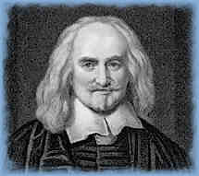
Geometric Proofs
Thomas Hobbes: Philosopher and scientist (1588 – 1679)
He was 40 years old before he looked in on Geometry, which happened accidentally. Being in a Gentleman’s library, Euclid’s Elements lay open and twas the 47 El libri 1. He read the proposition. By God sayd he (he would now and then swear an emphaticall Oath by way of emphasis) this is impossible! So he reads the Demonstration of it which referred him back to such a Proposition, which proposition he read. That referred him back to another which he also read. Et sic deinceps that at last he was demonstratively convinced of the trueth. This made him in love with Geometry.
From the life of Thomas Hobbes in John Aubrey’s Brief Lives, about 1694

Slide 26
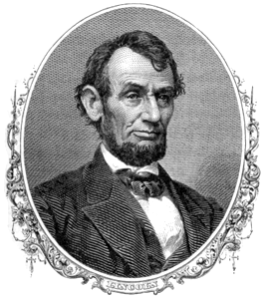
Abraham Lincoln: 16th U.S. President
(1809 – 65)
…"He studied and nearly mastered the Six-books of Euclid (geometry) since he was a member of Congress. He began a course of rigid mental discipline with the intent to improve his faculties, especially his powers of logic and language.
Hence his fondness for Euclid, which he carried with him on the circuit till he could demonstrate with ease all the propositions in the six books; often studying far into the night, with a candle near his pillow, while his fellow-lawyers, half a dozen in a room, filled the air with interminable snoring.“….
(Abraham Lincoln from Short Autobiography of 1860.)

Slide 27
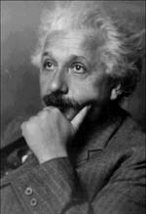
Albert Einstein
E = mc²
At the age of twelve I experienced a second wonder of a totally different nature: in a little book dealing with Euclidean plane geometry, which came into my hands at the beginning of a school year. Here were assertions as for example, the intersection of the 3 altitudes of a triangle in one point, which– though by no means evident, could nevertheless be proved with such certainty that any doubt appeared to be out of the question. This lucidity and certainty, made an indescribable impression upon me.
For example I remember that an uncle told me the Pythagorean Theorem before the holy geometry booklet had come into my hands. After much effort I succeeded in “proving” this theorem on the basis of similarity of triangles. For anyone who experiences [these feelings] for the first time, it is marvellous enough that man is capable at all to reach such a degree of certainty and purity in pure thinking as the Greeks showed us for the first time to be possible in geometry. From pp 9-11 in the opening autobiographical sketch of Albert Einstein: Philosopher – Scientist, edited by Paul Arthur.Schillp, published 1951

Slide 28
Proof 1/2
To Prove that the angle subtended by an arc or chord at the centre of a circle is twice the angle subtended at the circumference by the same arc or chord.
A
To prove that angle COB = 2 x angle CAB
Extend AO to D
β
α
AO = BO = CO (radii of same circle)
Triangle AOB is isosceles(base angles equal)
O
Triangle AOC is isosceles(base angles equal)
α
β
Angle AOB = 180 - 2α (angle sum triangle)
B
Angle AOC = 180 - 2β (angle sum triangle)
C
Angle COB = 360 – (AOB + AOC)(<‘s at point)
Angle COB = 360 – (180 - 2α + 180 - 2β)
D
Angle COB = 2α + 2β = 2(α+ β) = 2 x < CAB
Theorem 1 and 2
QED

Slide 29
Proof 3
To Prove that angles subtended by an arc or chord in the same segment are equal.
A
To prove that angle CAB = angle BDC
With centre of circle O draw lines OB and OC.
D
Angle COB = 2 x angle CAB (Theorem 1).
O
Angle COB = 2 x angle BDC (Theorem 1).
B
2 x angle CAB = 2 x angle BDC
Angle CAB = angle BDC
C
QED
Theorem 3

Slide 30
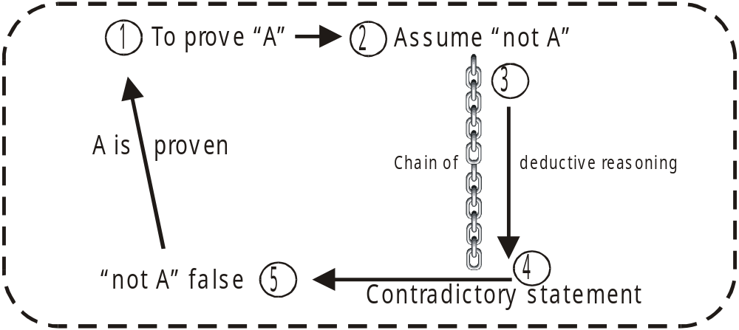
Proof 4
To prove that the angle between a tangent and a radius drawn to the point of contact is a right angle.
The type of proof that follows is a little different and is known as “Reductio ad absurdum” It was first exploited with great success by ancient Greek mathematicians. The idea is to assume that the premise is not true and then apply a deductive argument that leads to an absurd or contradictory statement. The contradictory nature of the statement means that the “not true” premise is false and so the premise is proven true.
Note that this proof is given primarily for your interest and completeness. Demonstration of the proof is beyond the GCSE course but is well worth looking at. The proofs up to now have been deductive proofs. That is they start with a premise, (a statement to be proven) followed by a chain of deductive reasoning that leads to the desired conclusion.

Slide 31
To prove that the angle between a tangent and a radius drawn to the point of contact is a right angle.
To prove that OT is perpendicular to AB
Assume that OT is not perpendicular to AB
Then there must be a point, D say, on AB such that OD is perpendicular to AB.
O
Since ODT is a right angle then angle OTD is acute (angle sum of a triangle).
C
D
But the greater angle is opposite the greater side therefore OT is greater than OD.
B
A
T
But OT = OC (radii of the same circle) therefore OC is also greater than OD, the part greater than the whole which is impossible.
Therefore OD is not perpendicular to AB.
By a similar argument neither is any other straight line except OT.
Therefore OT is perpendicular to AB.
Theorem 4
QED

Slide 32
Proof 5
To prove that the angle between a tangent and a chord through the point of contact is equal to the angle subtended by the chord in the alternate segment.
D
90 - α
B
2α
To prove that angle BTD = angle TCD
C
α
O
With centre of circle O, draw straight lines OD and OT.
α
90 - α
T
Let angle DTB be denoted by α.
Then angle DTO = 90 - α (Theorem 4 tan/rad)
Also angle TDO = 90 - α (Isos triangle)
A
Therefore angle TOD = 180 –(90 - α + 90 - α) = 2α (angle sum triangle)
Angle TCD = α (Theorem 1 angle at the centre)
Theorem 5
Angle BTD = angle TCD
QED

Slide 33
Proof 6
To prove that the opposite angles of a cyclic quadrilateral are supplementary (Sum to 180º).
B
To prove that angles A + C and B + D = 180⁰
β
α
Draw straight lines AC and BD
Chord DC subtends equal angles α (same segment)
A
δ
Chord AD subtends equal angles β (same segment)
α
γ
Chord AB subtends equal angles γ (same segment)
β
Chord BC subtends equal angles δ (same segment)
C
γ
δ
2(α + β + γ + δ) = 360º (Angle sum quadrilateral)
D
α + β + γ + δ = 180º
QED
Angles A + C and B + D = 180⁰
α
β
γ
δ
Theorem 6
alpha
beta
gamma
delta

Slide 34
Proof 7
To prove that the two tangents drawn from a point outside a circle are of equal length.
To prove that AP = BP.
A
With centre of circle at O, draw straight lines OA and OB.
OA = OB (radii of the same circle)
O
P
Angle PAO = PBO = 90º (tangent radius).
Draw straight line OP.
B
In triangles OBP and OAP, OA = OB and OP is common to both.
Triangles OBP and OAP are congruent (RHS)
Therefore AP = BP.
QED
Theorem 7

Slide 35
Proof 8
To prove that a line, drawn perpendicular to a chord and passing through the centre of a circle, bisects the chord.
To prove that AB = BC.
From centre O draw straight lines OA and OC.
O
In triangles OAB and OCB, OC = OA (radii of same circle) and OB is common to both.
Angle OBA = angle OBC (angles on straight line)
A
B
C
Triangles OAB and OCB are congruent (RHS)
QED
Therefore AB = BC
Theorem 8

Slide 36
Worksheet 1
Parts of the Circle

Slide 37
Worksheet 2
Measure the angle subtended at the centre (y) and the angle subtended at the circumference (x) in each case and make a conjecture about their relationship.
Th1
xº
xº
o
o
o
yº
yº
yº
xº
xº
xº
xº
o
o
o
yº
yº
yº

Slide 38
Worksheet 3
To Prove that the angle subtended by an arc or chord at the centre of a circle is twice the angle subtended at the circumference by the same arc or chord.
A
O
B
C
Theorem 1 and 2

Slide 39
Worksheet 4
To Prove that angles subtended by an arc or chord in the same segment are equal.
A
D
O
B
C
Theorem 3

Slide 40
Worksheet 5
To prove that the angle between a tangent and a radius drawn to the point of contact is a right angle.
O
B
A
T
Theorem 4

Slide 41
Worksheet 6
To prove that the angle between a tangent and a chord through the point of contact is equal to the angle subtended by the chord in the alternate segment.
D
B
C
O
T
A
Theorem 5

Slide 42
Worksheet 7
To prove that the opposite angles of a cyclic quadrilateral are supplementary (Sum to 180º).
B
A
C
D
α
β
χ
δ
Theorem 6
Alpha
Beta
Chi
delta

Slide 43
Worksheet 8
To prove that the two tangents drawn from a point outside a circle are of equal length.
A
O
P
B
Theorem 7

Slide 44
Worksheet 9
To prove that a line, drawn perpendicular to a chord and passing through the centre of a circle, bisects the chord.
O
A
B
C
Theorem 8

